Slide 1

12:34
12:39
12:49
12:52

Slide 2




Slide 4

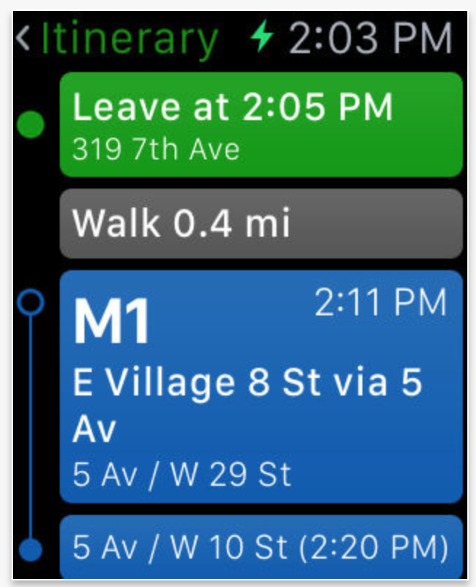


Slide 5


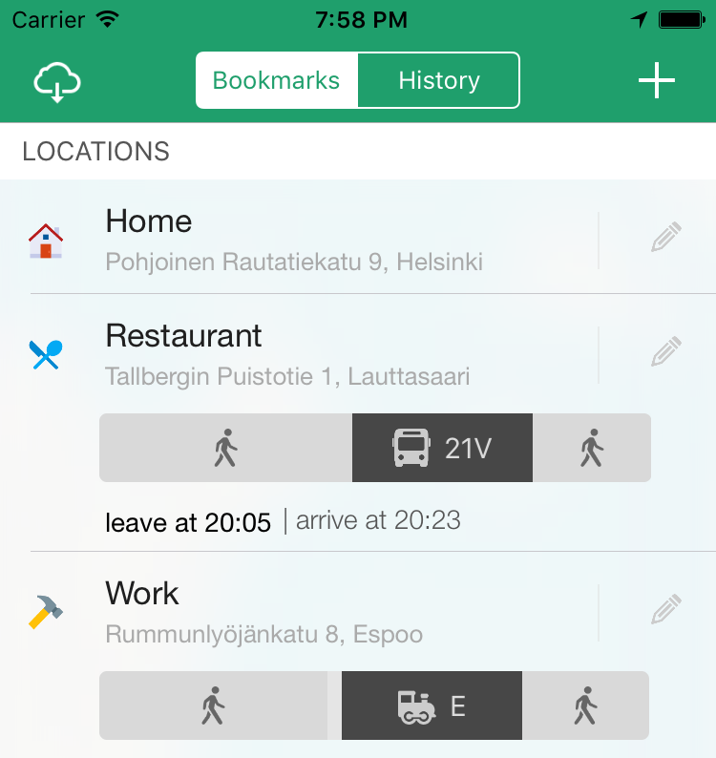

Slide 6



Slide 7


Slide 8








Slide 11


Slide 12
Helsinki 12:30
http://www.fontspace.com/category/thin?p=2
http://www.fontspace.com/nimavisual/trench

Slide 13




Slide 14





Slide 17






Slide 18
M

Slide 19


Slide 20



Slide 21


Slide 31



Slide 32


Slide 34








Slide 35





Slide 36


Ewket Apps
®
Ewket Apps
®

Slide 37










Slide 39




Slide 40


Slide 41



Slide 43
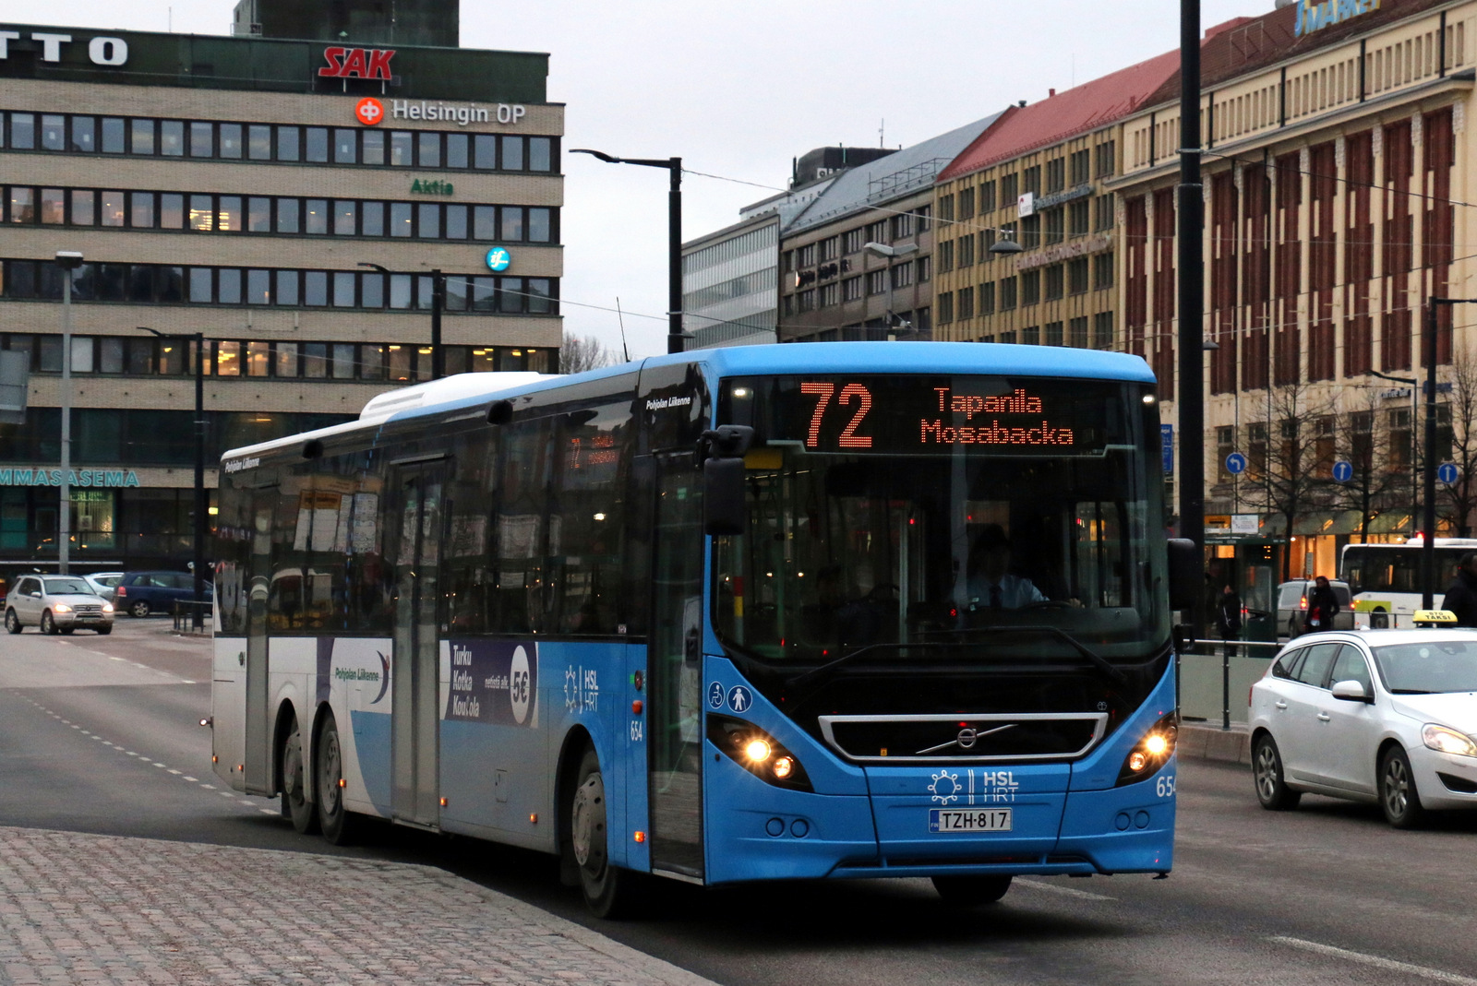


Slide 45


Slide 46
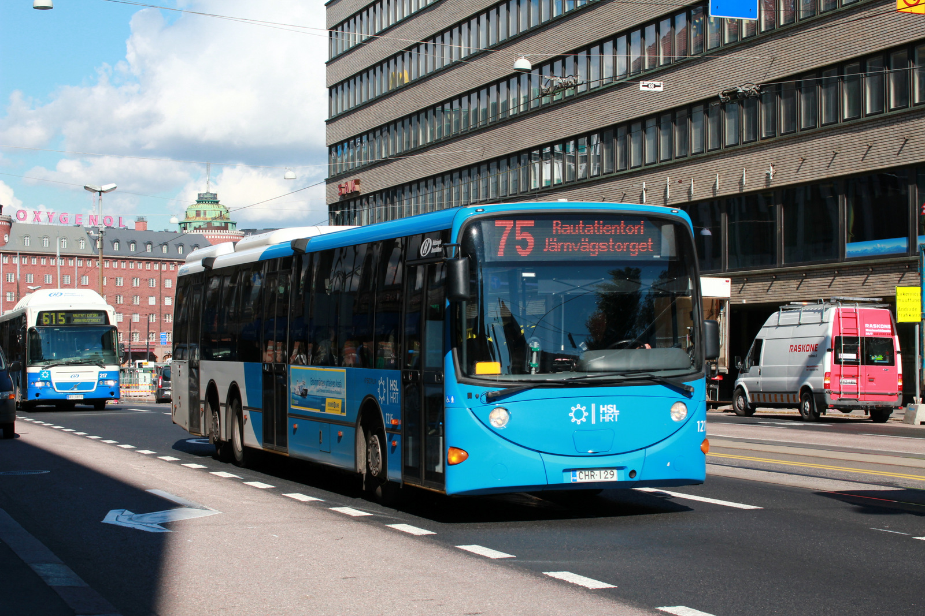

Slide 47


Slide 48


Slide 50
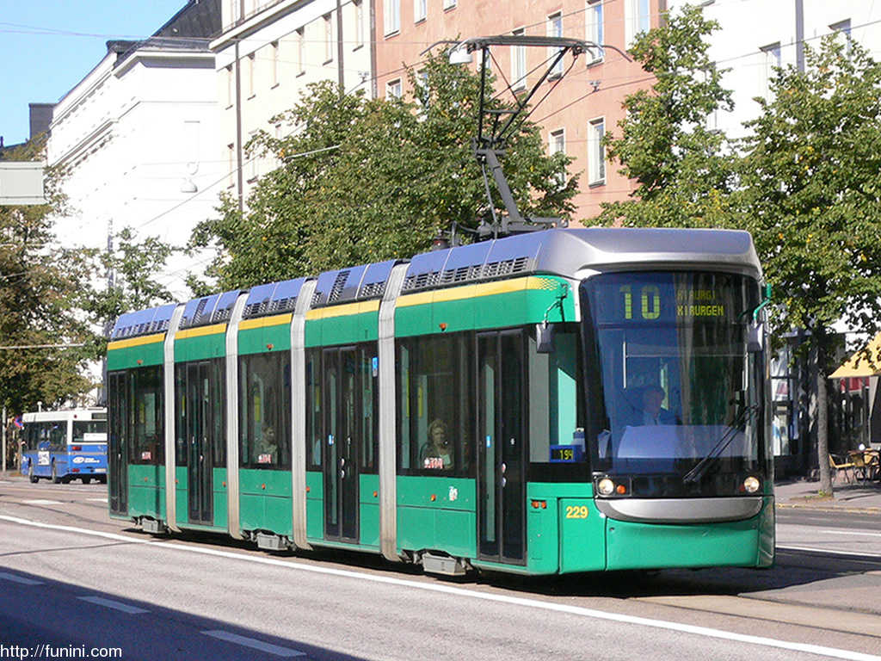

Slide 52


Slide 54
C
B
A - > C
B -> X
X = (b * C)/A
Dif = (A – B)/2
A
C * (1 – B/A)/2

